Slide 1
Advanced Encryption Standard (AES)

Slide 2
AGENDA
Advanced Encryption Standard
What is AES?
Why AES is so popular?
Design considerations of AES
What is state in AES and how to construct it?
Schematic Diagram and Flowchart of AES Algorithm
Encryption
Encryption Process
Different Processes of Encryption
Decryption
Details of the steps of AES
Attacks on AES

Slide 3
Advanced Encryption Standard The Algorithm was developed by Vincent Rijmen and Joan Daemen. So this is also called RIJNDAEL.

Slide 4
What is AES?
AES is an encryption standard chosen by the National Institute of Standards and Technology(NIST), USA to protect classified information. It has been accepted world wide as a desirable algorithm to encrypt sensitive data.
It supersedes the Data Encryption Standard (DES), which was published in 1977.
The algorithm described by AES is a symmetric-key algorithm, meaning the same key is used for both encrypting and decrypting the data.
It is based on both permutation and substitution techniques.

Slide 5
Why AES is so popular? (1/2)
The cracking of Data Encryption Standard(DES) was becoming possible. AES overcomes the limitation of the smaller key size of DES by utilizing a bigger and variable-length key.
Moreover, it also resolves the slow processing speed of Triple-DES and utilizes lower resources than the earlier one.
AES met all security, cost and implementation criteria and it was accepted by the US government to protect classified information.

Slide 6
Why AES is so popular? (2/2)
AES supports secret keys of three lengths which are of 128, 192, 256 bits to encrypt and decrypt a data block of 128 bits.
It is flexible and has implementation for software and hardware.
It doesn’t have any copyright so it can be easily used globally.
Overall, this robust algorithm provides high security and can prevent many attacks.

Slide 7
Design Considerations of AES (1/2)
AES is based on ‘substitution–permutation network’. It comprises a series of linked operations, some of which involve replacing inputs by specific outputs (substitutions) and others involve shuffling bits around (permutations).
Interestingly, AES performs all its computations on bytes rather than bits. Hence, AES treats the 128 bits of a plaintext block as 16 bytes. These 16 bytes are arranged in four columns and four rows for processing as a matrix

Slide 8
Design Considerations of AES (2/2)
Unlike DES, the number of rounds in AES is variable and depends on the length of the key. AES uses 10 rounds for 128-bit keys, 12 rounds for 192-bit keys, and 14 rounds for 256-bit keys. Each of these rounds uses a different 128-bit round key, which is calculated from the original AES key.
Every key is expanded so that a separate sub-key (denoted as w[i,j], where i and j provide the byte range) could be utilized for every round.
It is clear from the above discussion that number of rounds depends on the key length.

Slide 9
What is state in AES
The block of data to be encrypted is termed the state. In AES the state is a (4×4) matrix of bytes. The state paired with an encryption key of a certain length form the inputs for the AES algorithm. The AES is comprised of four different stages, which together represent a single round. Each stage performs some operations on the current state. The number of rounds varies with different implementations of AES.

Slide 10
How to construct state in AES?
Key Length (N_{k}) in words (1 word = 32 bits or 4 bytes) | No. of Columns in State (N_{b}) | Rounds (N_{r})
4 (128 bits) | 4 | 10
6 (192 bits) | 6 | 12
8 (256 bits) | 8 | 14
Number of Columns in State N_{b} = N_{k} ( i.e., Key length in bits / 32)

Slide 11
Example of a State with 128-bit Key Length
S_{0,0} | S_{0,1} | S_{0,2} | S_{0,3}
S_{1,0} | S_{1,1} | S_{1,2} | S_{1,3}
S_{2,0} | S_{2,1} | S_{2,2} | S_{2,3}
S_{3,0} | S_{3,1} | S_{3,2} | S_{3,3}

Slide 12
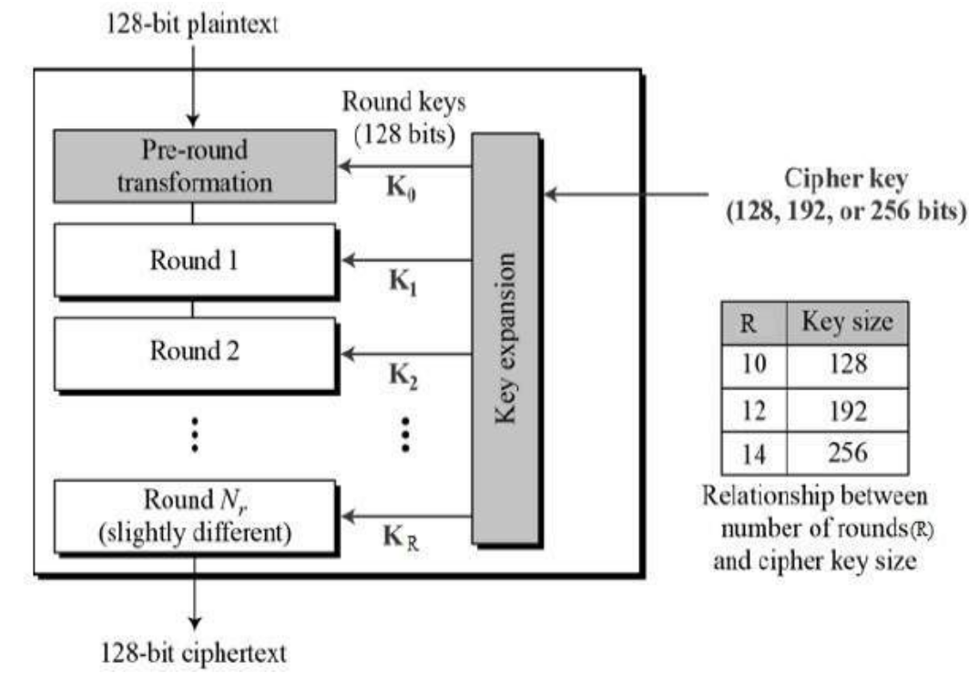
Schematic Diagram of AES Structure

Slide 13
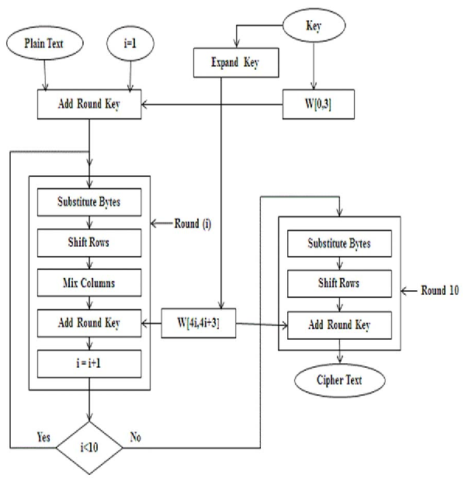
Flowchart of AES Algorithm

Slide 14
DETAILS OF ENCRYPTION PROCESS

Slide 15
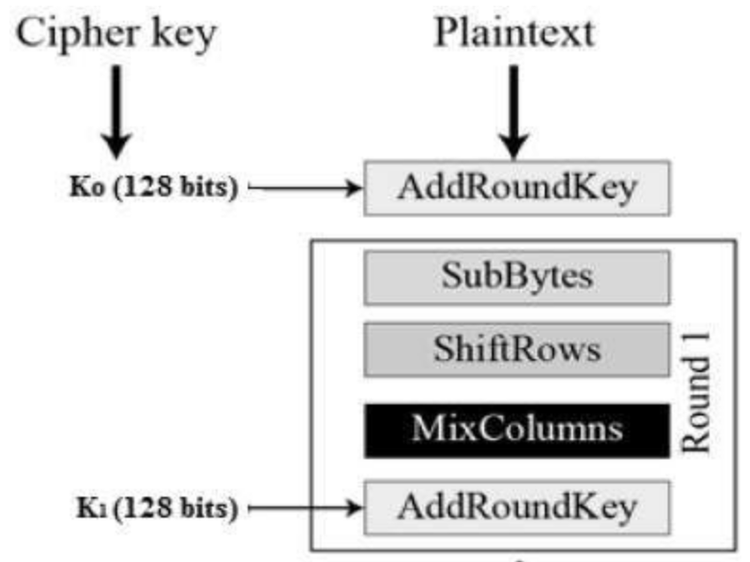
Encryption Process (1/3)
AES basically repeats four major functions to encrypt data. It takes 128 bit block of data and a key and gives a cipher text as output. The functions it performs are as follows :
Byte Substitution
Shift Rows
Mix Columns
Add round key

Slide 16
Encryption Process (2/3)
Byte Substitution (SubBytes)
The 16 input bytes (for 128-bit key) are substituted by looking up a fixed table (S-box) given in the design. The result is in a matrix of four rows and four columns.
Shift rows
Each of the four rows of the matrix is shifted to the left. Any entries that ‘fall off’ are re-inserted on the right side of the row. The shift is carried out as follows −
First row is not shifted.
Second row is shifted one (byte) position to the left.
Third row is shifted two positions to the left.
Fourth row is shifted three positions to the left.
The result is a new matrix consisting of the same 16 bytes but shifted with respect to each other.

Slide 17
Encryption Process (3/3)
MixColumns
Each column of four bytes is now transformed using a special mathematical function.
This function takes as input the four bytes of one column and outputs four completely new bytes, which replace the original column.
The result is another new matrix consisting of 16 new bytes.
It should be noted that this step is not performed in the last round.
Add round key
The 16 bytes of the matrix are now considered as 128 bits and are XORed to the 128 bits of the round key.
If this is the last round then the output is the ciphertext.
Otherwise, the resulting 128 bits are interpreted as 16 bytes and we begin another similar round.

Slide 18
DETAILS OF DECRYPTION PROCESS

Slide 19
Decryption Process
The process of decryption of an AES cipher text is similar to the encryption process in the reverse order. Each round consists of the four processes conducted in the reverse order :
Add round key
Mix columns
Shift rows
Byte substitution
Since sub-processes in each round are in reverse manner, unlike for a Feistel Cipher, the encryption and decryption algorithms needs to be separately implemented, although they are very closely related.

Slide 20
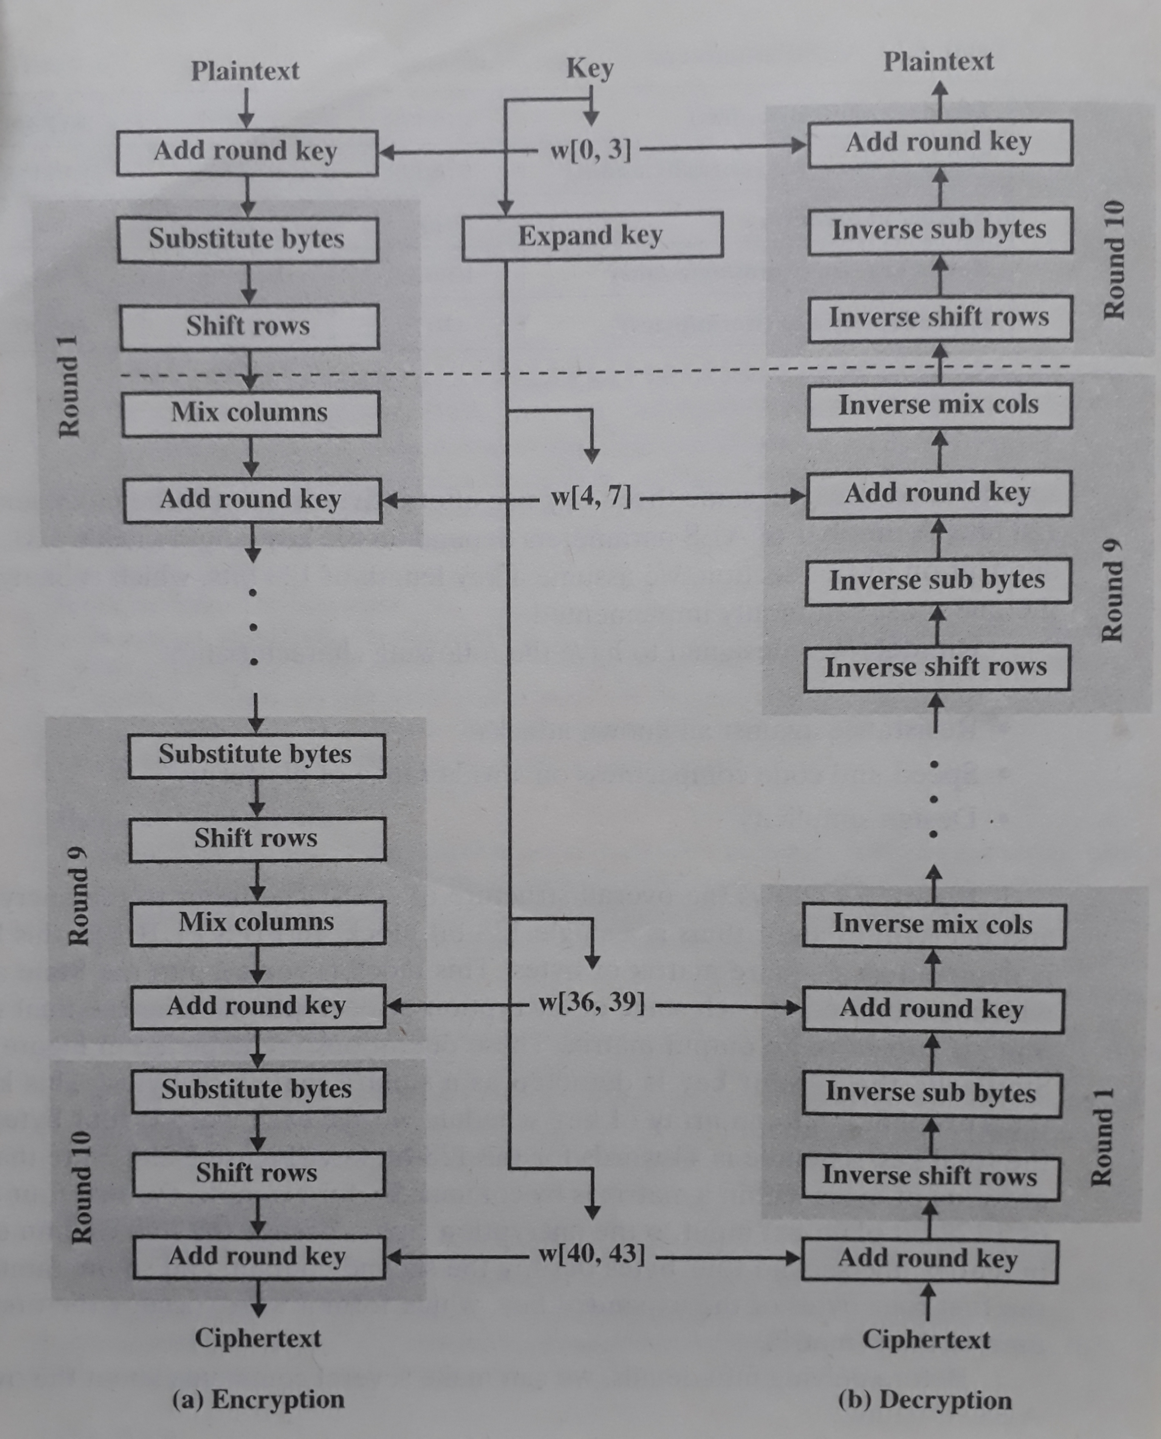
Overall Structure of AES Encryption & Decryption

Slide 21
DETAILED ANALYSIS OF THE STEPS OF AES

Slide 22
Key Expansion (1/5)
In the key expansion process the given 128 bits cipher key is stored in [4]x[4] bytes matrix (16*8=128 bits) and then the four column words of the key matrix is expanded into a schedule of 44 words (44*4=176) resulting in 11 round keys (176/11=16 bytes or 128 bits).
Number of round keys = Nr + 1 where Nr is the number of rounds (which is 10 in case of 128 bits key size). So here the round keys = 11.

Slide 23
Key Expansion (2/5)
Steps:
1) RotWord – A one-byte circular left shift on a word.
2) SubWord – Performs a byte substitution on each byte of its input word, using a S-box.
3) XOR with round constant – The result obtained from the previous step is XORed with a round constant, Rcon.
NOTE : (The Rcon depends on round number).

Slide 24
An Example of Key Expansion (3/5)
Suppose that the initial round key for round 8 is as follows.
EA D2 73 21 B5 8D BA D2 31 2B 5F 60 7F 8D 29 2F
This can be written in matrix form as follows.
EA | B5 | 31 | 7F
D2 | 8D | 2B | 8D
73 | BA | 5F | 29
21 | D2 | 60 | 2F

Slide 25
Example Continued (4/5)
Considering the previous matrix (for round 8) we can write –
w[32]=EA D2 73 21 [i=32]
w[33]=B5 8D BA D2 [i=33]
w[34]=31 2B 5F 60 [i=34]
w[35]=7F 8D 29 2F [i=35]
Then the first four bytes (first column) of the round key for round 9 are calculated as follows:
i | Temp = w[i-1] = w[35]) | Temp = RotWord(Temp) | Temp = SubWord(Temp) | Rcon (9) | Temp = Temp XOR Rcon(9) | w[i-4] =w[32] | w[i] = w[36] = Temp XOR w[i-4]
36 | 7F 8D 29 2F | 8D 29 2F 7F | 5D A5 15 D2 | 1B000000 | 46 A5 15 D2 | EA D2 73 21 | AC 77 66 F3

Slide 26
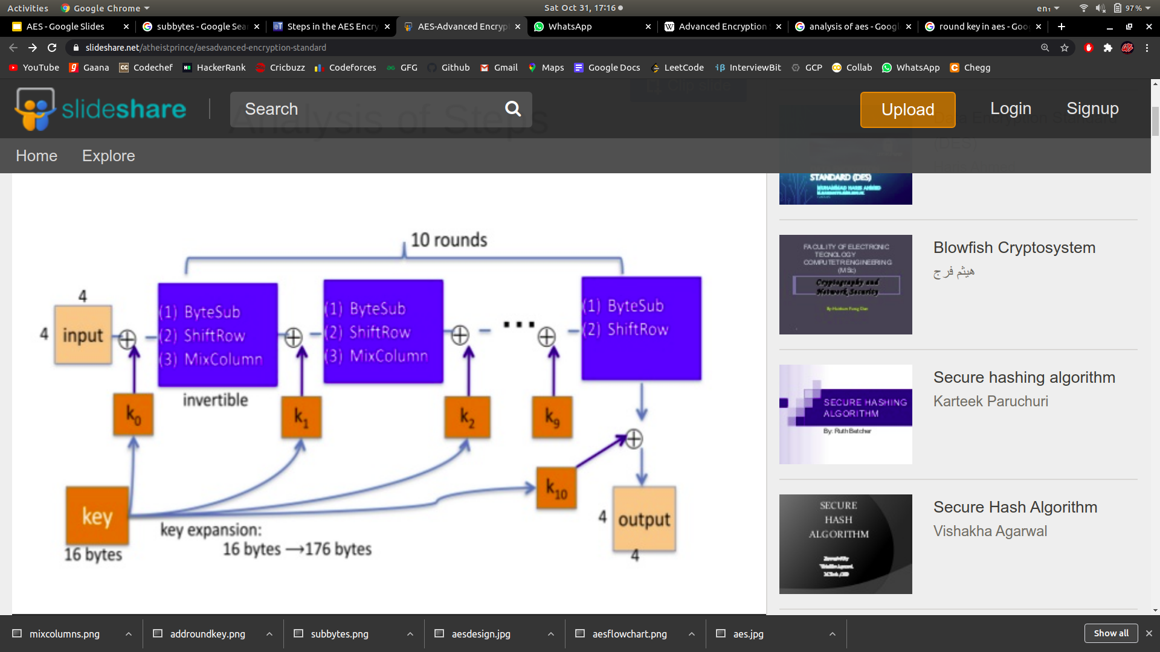
Key Expansion Briefing (5/5)
Key Expansion

Slide 27
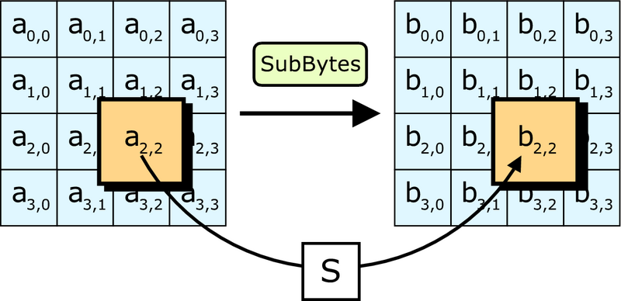
Byte Substitution (1/2)
Each element of the matrix is replaced by an element of S-box matrix.

Slide 28
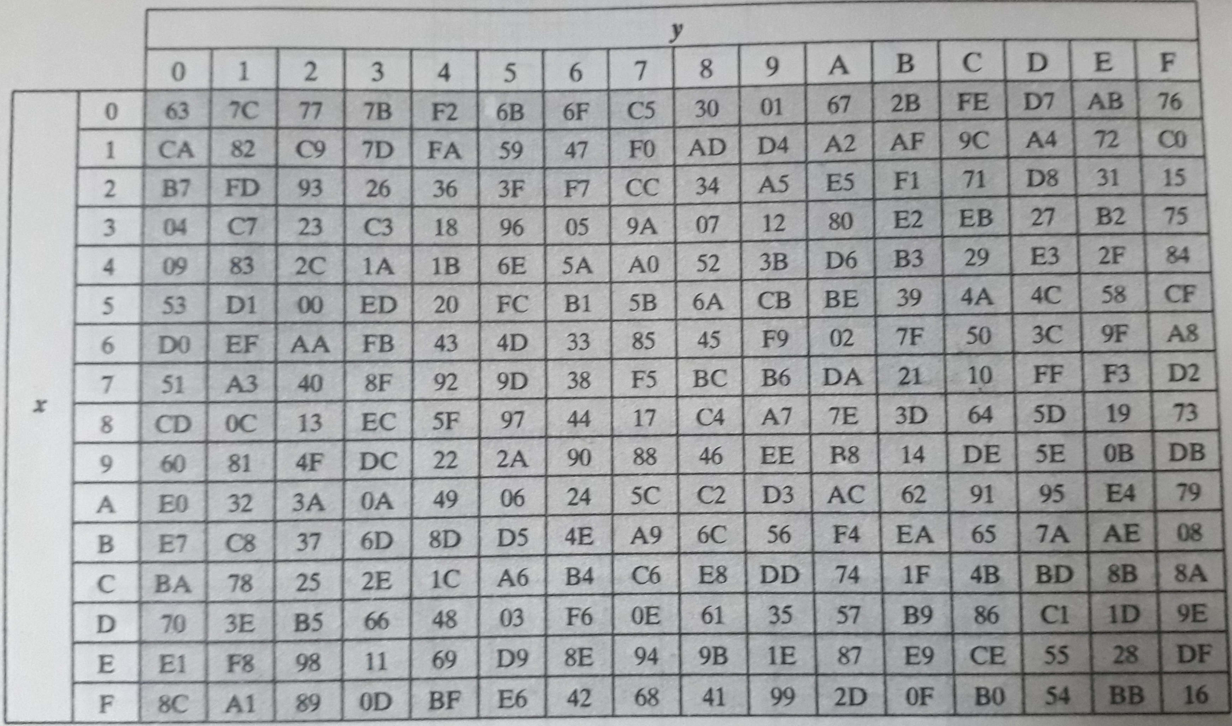
Rjindael S-box used for Byte Substitution (2/2)
S-box is a special lookup table which is constructed by Galois fields.
Generating Function used here is GF(2⁸) i.e, 256 values are possible.
The elements of the S-box are written in hexadecimal system. The first digit represents row and the second digit represents column.

Slide 29
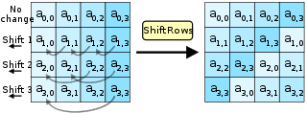
Shift Rows (1/2)
In this step rows of the block are cylindrically shifted in left direction. The first row is untouched, the second one by one shift, third by two and fourth by three.

Slide 30
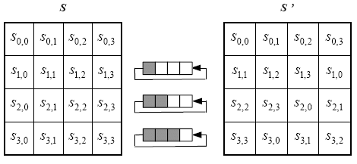
An Example of Shift Rows (2/2)

Slide 31
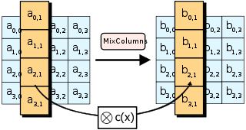
Mix Columns (1/4)
This is the most important part of AES Algorithm. It causes the flip of bits to spread all over the block. In this step the block is multiplied by a fixed matrix. The multiplication is field multiplication in Galois field. For each row there are 16 multiplication, 12 XORs and a 4 byte output.

Slide 32
An Example of Mix Columns (2/4)
It operates on each column individually where a single byte of a column is mapped into a new value that is a function of all four bytes in that column. The transformation can be defined by the following matrix multiplication on state.
S_{0,0} | S_{0,1} | S_{0,2} | S_{0,3}
S_{1,0} | S_{1,1} | S_{1,2} | S_{1,3}
S_{2,0} | S_{2,1} | S_{2,2} | S_{2,3}
S_{3,0} | S_{3,1} | S_{3,2} | S_{3,3}
02 | 03 | 01 | 01
01 | 02 | 03 | 01
01 | 01 | 02 | 03
03 | 01 | 01 | 02

Slide 33
Example of Mix Columns Continued (3/4)
S_{0,0} = (S_{0,0} * 02) XOR (S_{1,0} * 03) XOR (S_{2,0} * 01) XOR (S_{3,0} * 01)
S_{1,0} = (S_{0,0} * 01) XOR (S_{1,0} * 02) XOR (S_{2,0} * 03) XOR (S_{3,0} * 01)
S_{2,0} = (S_{0,0} * 01) XOR (S_{1,0} * 01) XOR (S_{2,0} * 02) XOR (S_{3,0} * 03)
S_{3,0} = (S_{0,0} * 03) XOR (S_{1,0} * 01) XOR (S_{2,0} * 01) XOR (S_{3,0} * 02)
Note that * multiplications are not traditional multiplications but can be performed using two Look-up tables called L-Table and E-Tables.
One such example for calculating only S_{0,0} is shown in the next slide.

Slide 34
Example of Mix Columns Continued (4/4)
Example: Let, Input = 87 6E 46 A6
So,
S_{0,0} = (S_{0,0} * 02) XOR (S_{1,0} * 03) XOR (S_{2,0} * 01) XOR (S_{3,0} * 01)
= (87 * 02) XOR (6E * 03) XOR (46 * 01) XOR (A6 * 01)
= E(L(87)+L(02)) XOR E(L(6E)+L(03)) XOR E((L(46)+L(01))
XOR E(L(A6)+L(01))
= E(74+19) XOR E(………) ………….
= E(8D) XOR …………
= 15 XOR …………..

Slide 35
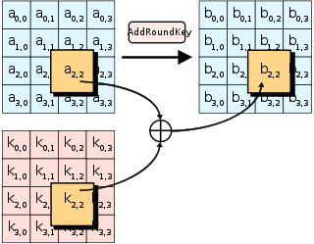
Add Round Key
In this step each byte of the STATE is XORed with corresponding byte of the round key. Since using same key weaken the algorithm. Hence keys are expanded using the procedure as explained earlier.

Slide 36
Attacks on AES (1/2)
Attack on AES Implementation Exploiting Publicly-visible Partial Result:
Source research paper :
Attack on AES Implementation Exploiting Publicly-visible Partial Result, by William Diehl , 2017
Although AES is designed to be secure against a wide variety of linear and differential attacks, security ultimately depends on a combination of the engineering implementation and proper application by intended users. In this work, the authors attack a publicly-available VHDL implementation of AES by exploiting a partial result visible at the top-level public interface of the implementation. The vulnerability renders the security of the implementation equivalent to a one-round version of AES. They proposed an algorithm that exploits this vulnerability to recover the secret key in 2³¹ operations. The algorithm is coded in an interpreted high-level language and successfully recovers secret keys, with one set of known plaintext, using a general-purpose CPU in an average of 30 minutes.

Slide 37
Attacks on AES (2/2)
Known-key distinguishing attack:
Known-key distinguishing attacks were first introduced in 2007 by Lars Knudsen and Vincent Rijmen in a paper that proposed such an attack against 7 out of 10 rounds of the AES cipher and another attack against a generalized Feistel cipher. Their attack finds plaintext/ciphertext pairs for a cipher with a known key, where the input and output have s least significant bits set to zero, in less than 2 s time (where s is fewer than half the block size).
Side-channel attacks:
Side-channel attacks do not attack the cipher as a black box, and thus are not related to cipher security as defined in the classical context, but are important in practice. They attack implementations of the cipher on hardware or software systems that inadvertently leak data. There are several such known attacks on various implementations of AES.

Slide 38
THANK YOU

